Slide 1



NAMI GROUP
INVESTMENT
BANKING
High-impact financial blueprints and transaction advisory models designed to secure major capital placements and execute mergers.
WWW.NAMIGROUP.IN
Structuring • Capital • Exits

Slide 2






01 / OVERVIEW
CORE ADVISORY OFFERINGS
Our financial architecture integrates continuous market intelligence with elite structural design. We combine strategic counsel with institutional-grade execution models.
PILLAR 01
PILLAR 02
PILLAR 03
PILLAR 04
PILLAR 05
CAPITAL MARKET
MERGERS & ACQUISITIONS
STRUCTURED FINANCE
SUPPORT SERVICES
SUSTAINABILITY
Public & private equity placements and structured debt syndication models across active sovereign corridors.
Green capital placement strategies, transition frameworks, and derivatives-based market hedging algorithms.
Strategic sell-side optimization, buy-side target maps, and comprehensive cross-border joint venture mandates.
Leveraged buyout debt stacks, mezzanine options, waterfall configurations, and customized funding structures.
Institutional-grade financial valuation modeling, validation reports, investor memorandum packs, and diligence rooms.

Slide 3

02 / CAPITAL MARKETS
CAPITAL MARKET ADVISORY
Comprehensive advisory across public mainboards and private credit markets, delivering robust placement rates.
business_center STRUCTURED SOLUTIONS
▪IPO & SME Listings: Full-scope placement preparation and prospectus filing.
▪Debt Capital: Access to a network of 135+ global credit lenders and institutional funds.
USD 120M+
EQUITY PLACED
USD 157M+
DEBT MOBILIZED

Slide 4

03 / M&A ADVISORY
MERGERS & ACQUISITIONS
End-to-end strategic advice backed by rigorous validation, asset intelligence, and target match algorithms.
insights EXECUTION STRATEGY
▪Buy-Side Strategy: Precise market screen maps and diligence pipelines.
▪Sell-Side Optimization: Premium confidential memorandums and structural positioning.
245+ Deals
ADVISED & CLEARED
USD 2.0B+
COMBINED DEAL VALUE

Slide 5

04 / CUSTOMIZED STRUCTURING
STRUCTURED FINANCE
Bespoke customization of corporate capital layers, balancing overall cost of funding with operational flexibility.
layers STACK COMPONENTS
▪Acquisition Finance: Mezzanine options, unitranche, and hybrid structures.
▪Waterfall Design: Custom equity return stacks and structural optimization plans.
45+ Transactions
LBOS STRUCTURED
USD 85M+
PROJECT FINANCE STACK

Slide 6


05 / PILLARS
DEAL SUPPORT PILLARS
Our foundational execution layers ensure transactions strictly align with international valuation standards and compliance limits.
SUPPORT 01
SUPPORT 02
SUPPORT 03
SUPPORT 04
RESEARCH & VALUATIONS
EXECUTION SUPPORT
RISK & COMPLIANCE
CLIENT RELATIONS
Strategic investor data room setup, credential compilations, and structural diligence reviews for rapid closing.
Comprehensive transaction governance, cross-border compliance checks, and regulatory alignments.
Sustained strategic advisory post-deal, custom portfolio reporting schedules, and key stakeholder alignments.
Granular cash flow projections, DCF valuation models, and operational benchmark analysis across target industries.

Slide 7
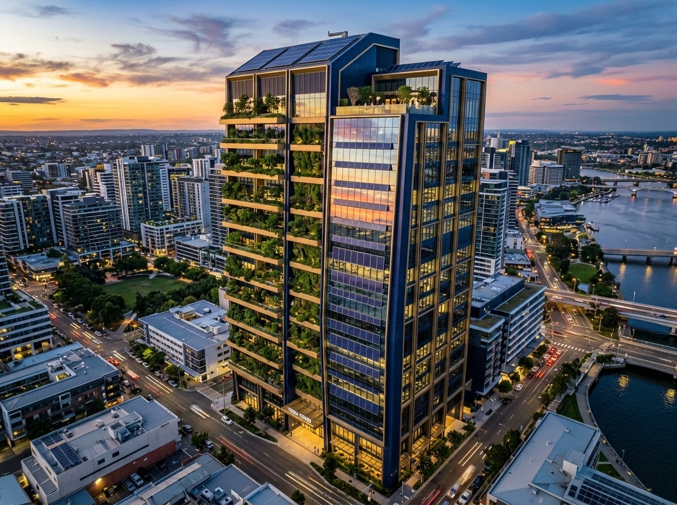
06 / ESG & RISK
SUSTAINABILITY & RISK
Mobilising sustainable capital and deploying strategic derivatives strategies to insulate cross-border transactions from systemic volatility.
security DEFENSE MEASURES
▪Sustainable Financing: Structuring green, social, and sustainability-linked options.
▪Risk Advisory: FX, interest rate, and currency swap modelling to manage cash flows.
USD 45M+
GREEN DEAL ALLOCATIONS
18+ Active
HEDGING FRAMEWORKS

Slide 8






07 / INDUSTRY FOCUS
GLOBAL SECTOR COVERAGE
30% MARKET DEPTH
25% MARKET DEPTH
15% MARKET DEPTH
TECH & FINTECH
INDUSTRIALS & MFG
CONSUMER & RETAIL
Enterprise SaaS, payments infrastructure, cybersecurity, and advanced software ecosystems seeking capital rounds.
Aerospace components, precision engineering systems, advanced automotive parts, and speciality chemicals.
Omnichannel premium brands, e-commerce platforms, food & beverage chains, and consumer network setups.
12% MARKET DEPTH
10% MARKET DEPTH
8% MARKET DEPTH
HEALTHCARE
ENERGY & RESOURCES
REAL ESTATE & PROPTECH
Medical devices, tech-enabled clinical setups, specialized diagnostic networks, and digital healthcare platforms.
Solar arrays, infrastructure projects, traditional utilities, and renewable transition syndicates.
Logistics spaces, commercial properties, hotel developments, and property technology software setups.

Slide 9


08 / CORE COMMITMENT
COMMITMENT TO EXCELLENCE
Blending the comprehensive analytical depth of tier-one banks with the dedicated focus of an elite corporate advisory boutique.
STEP 01
STEP 02
STEP 03
STEP 04
STEP 05
SENIOR-LED FOCUS
INSTITUTIONAL GRADE
DOMAIN EXPERTISE
GLOBAL PLACEMENT
RESULT ORIENTATION
Direct operational management from highly experienced directors on every transaction.
Impeccable quality controls and structured finance models designed to clear regulatory audits.
Decades of combined corporate transaction experience with global capital corridors.
Vast network linking strategic partners across major offshore investment corridors.
Committed to robust advisory execution and absolute final deal closing.

Slide 10
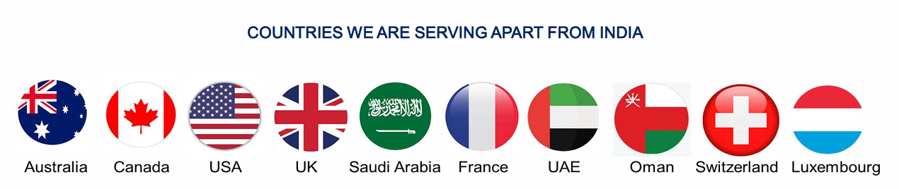
09 / PARTNERSHIPS
GLOBAL CONNECTIVITY & CHANNELS
handshake STRATEGIC CHANNELS
public SERVING KEY MARKETS
▪ BRICS Chamber: Official chamber alignment to accelerate capital flow pathways.
▪ UK Department of Trade: Active corridor support with deputy high commissions.
▪ Embassy Networks: Structural transaction pathways across key sovereign business hubs.
Active international corridors outside mainland India:
●USA
●UAE
●UK
●France
●Switzerland
●Saudi Arabia
COUNTRIES WE ARE SERVING APART FROM INDIA

Slide 11







10 / TRACK RECORD
PROVEN STRATEGIC FOOTPRINT
We bring seasoned financial capability and rigorous advisory execution, backed by a strong performance history.
110+
USD 277M+
135+
150+
YEARS COMBINED
FUNDS MOBILIZED
GLOBAL LENDERS
BLUEPRINTS
Collective domain depth across our specialized advisory team of CAs, CSs, and veteran MBAs.
Successfully channelized nearly INR 2500+ Crores of cross-border institutional capital.
Direct connections with global Tier-1 banks, sovereign funds, and private family offices.
Rigorous compilation of investment structure files and institutional sanction documents.
285+
245+
USD 2.0B+
11+
VALUATIONS
M&A TRANSACTIONS
ADVISORY VALUE
GLOBAL COUNTRIES
Asset and business valuations prepared, assessed, and backed across diverse regulatory bodies.
Sector-agnostic transactions, strategic corporate deals, and due diligence advisory.
Total deal value successfully advised on across complex corporate restructurings and exits.
Active client transactions executed across key offshore hubs outside mainland India.

Slide 12
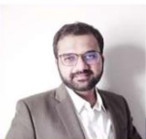
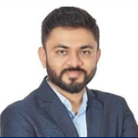
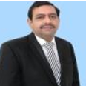


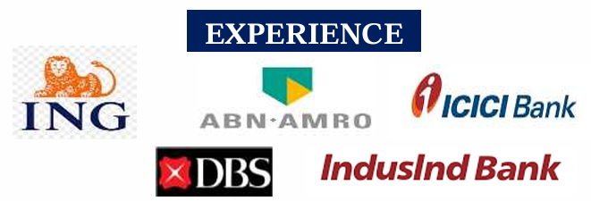
11 / LEADERSHIP
EXECUTIVE BOARD DIRECTORS
DIPEN U. SHAH
FOUNDER DIRECTOR • CA | CS
SHAIL SHAH
DIRECTOR - M&A & TAX • CA
DHIREN PANCHAL
DIRECTOR - GLOBAL BANKING • CFA
18+ Years: ING, Kotak Mahindra Bank & senior structures.
Depth: Capital markets, offshore setups, fund mobilisation.
15+ Years: Regulatory leadership, corporate taxation schemes.
Depth: Advanced M&A valuation, global corporate frameworks.
20+ Years: ICICI Bank, ABN Amro, HSBC, Yes Bank, DBS Bank.
Depth: Global banking networks, structures, FEMA guidelines.

Slide 13
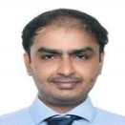
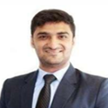



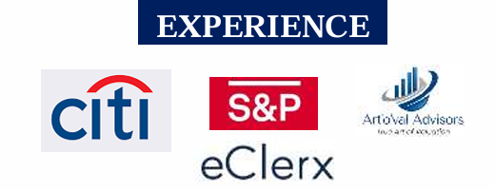
12 / LEADERSHIP
STRATEGIC EXECUTION DIRECTORS
PIYUSH AKHAJA
DIRECTOR - EQUITY ADVISORY
MAHIT PURI
DIRECTOR - VALUATION • CA
ARPI AKHAJA
HEAD - MODELING & MIS
15+ Years: Investment Banking, corporate structuring.
Depth: Detailed operational models, DCF valuation, exits.
14+ Years: Debt Syndication, capital placement operations.
Depth: Structured finance structures, cross-border deal flow.
12+ Years: Corporate financial planning & portfolio analysis.
Depth: Structural modeling, validation, databases.

Slide 14


13 / CONTACT
PARTNER WITH US
Secure structural alignment and close high-value transactions with elite global advisory and placement networks.
INQUIRIES
GLOBAL FOOTPRINT
CORPORATE LINE
ib@namigroup.in
India • UAE • USA • UK
+91-97250 53938
+971 58 57 4 3938
WWW.NAMIGROUP.IN

